Slide 1
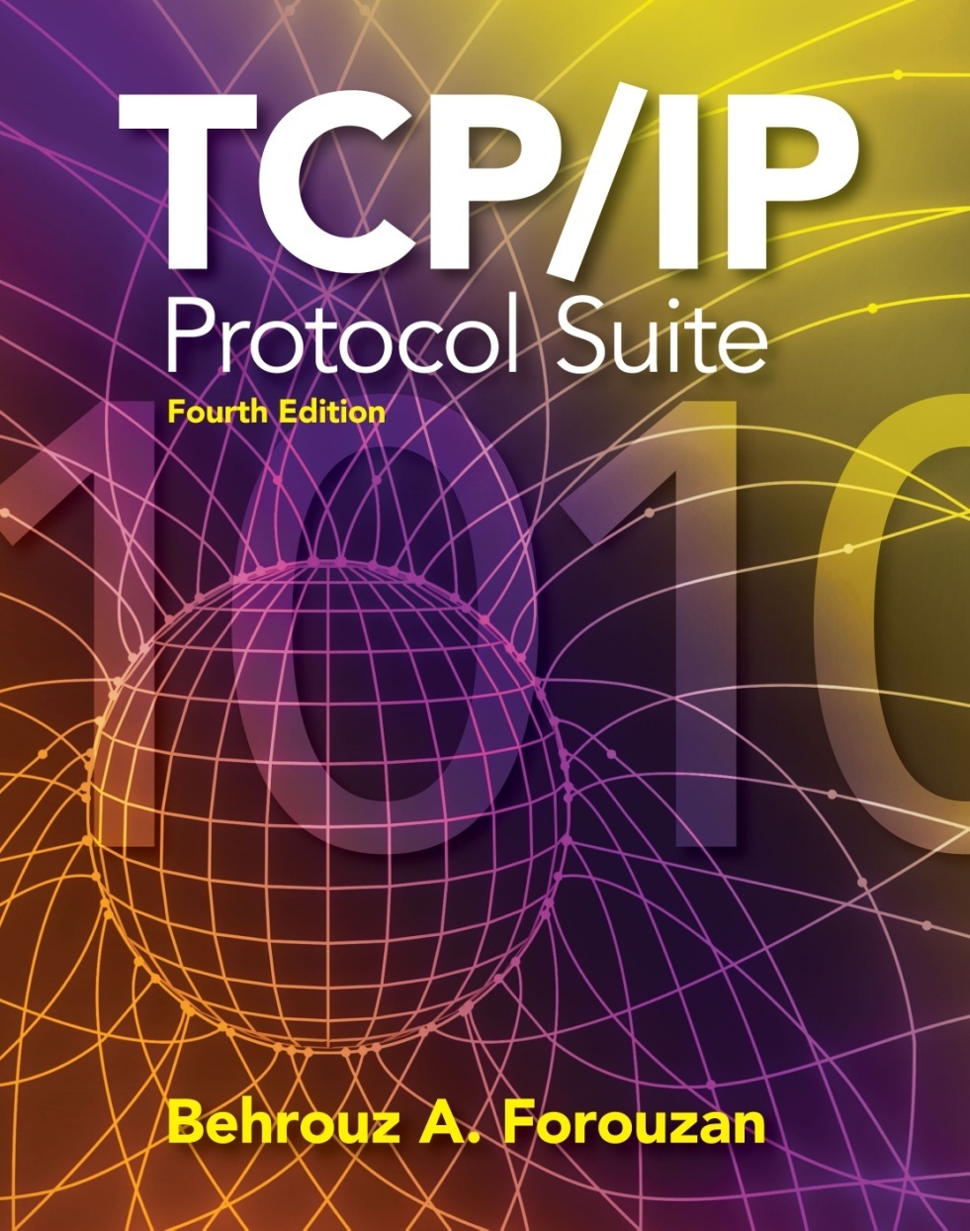
User Datagram
Protocol (UDP)
TCP/IP Protocol Suite
1
Copyright © The McGraw-Hill Companies, Inc. Permission required for reproduction or display.
Notes:
1

Slide 2
OBJECTIVES:
To introduce UDP and show its relationship to other protocols in the TCP/IP protocol suite.
To explain the format of a UDP packet and discuss the use of each field in the header.
To discuss the services provided by the UDP such as process-to-process delivery, multiplexing/demultiplexing, and queuing.
To show how to calculate the optional checksum (and the sender needs to add a pseudoheader to the packet when calculating the checksum.)
To discuss how some application programs can benefit from the simplicity of UDP.
To briefly discuss the structure of the UDP package.
TCP/IP Protocol Suite
2
Notes:
2

Slide 3
Chapter Outline
14.1 Introduction
14.2 User Datagram
14.3 UDP Services
14.4 UDP Application
14.5 UDP Package
TCP/IP Protocol Suite
3
Notes:
3

Slide 4
14-1 INTRODUCTION
Figure 14.1 shows the relationship of the User Datagram Protocol (UDP) to the other protocols and layers of the TCP/IP protocol suite: UDP is located between the application layer and the IP layer, and serves as the intermediary between the application programs and the network operations.
TCP/IP Protocol Suite
4
Notes:
4

Slide 5
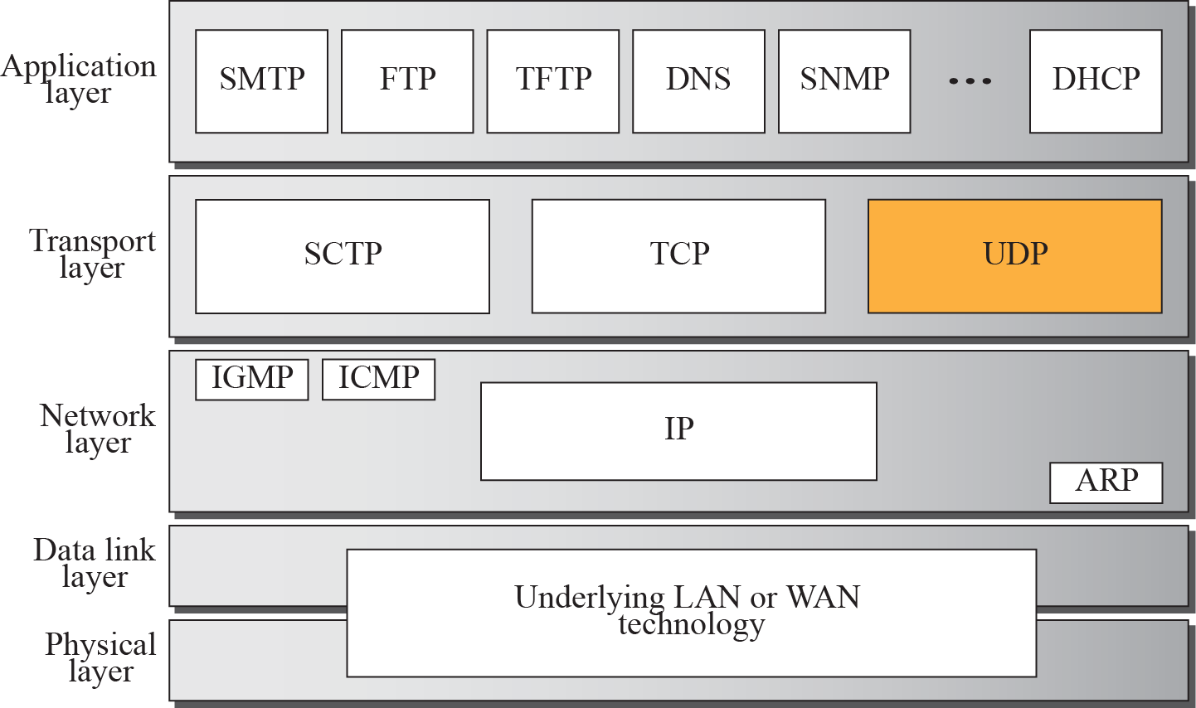
Figure 14.1 Position of UDP in the TCP/IP protocol suite
TCP/IP Protocol Suite
5
Notes:
5

Slide 6
14-2 USER DATAGRAM
UDP packets, have a fixed-size header of 8 bytes. Figure shows the format of a user datagram.
TCP/IP Protocol Suite
6
Notes:
6

Slide 7
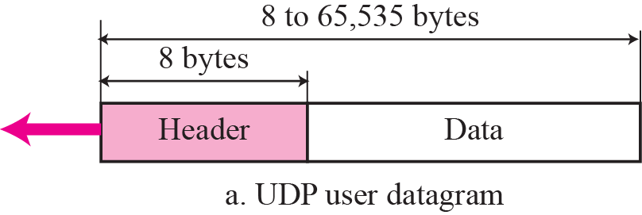
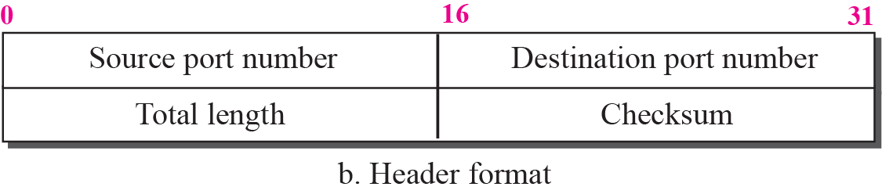
Figure 14.2 User datagram format
TCP/IP Protocol Suite
7
Notes:
7

Slide 8
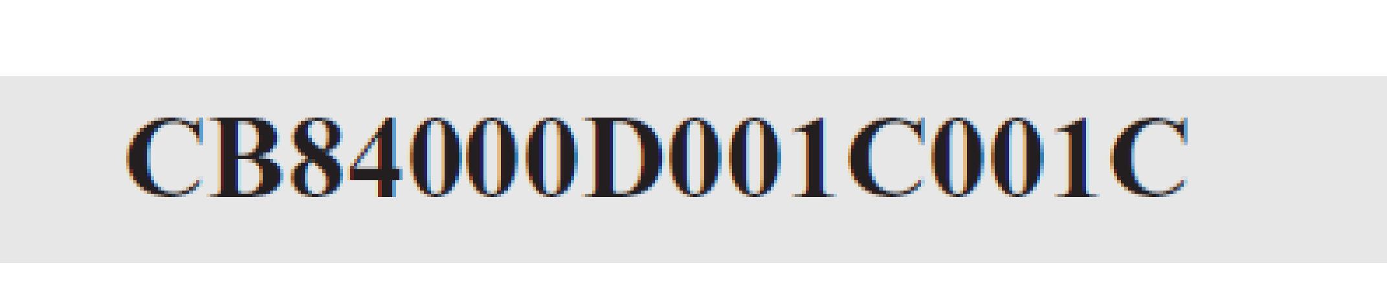
Example 14.1
The following is a dump of a UDP header in hexadecimal format.
a. What is the source port number?
b. What is the destination port number?
c. What is the total length of the user datagram?
d. What is the length of the data?
TCP/IP Protocol Suite
8
Notes:
8

Slide 9
Example 14.1 Continued
Solution
a. The source port number is the first four hexadecimal digits (CB84)₁₆ or 52100.
b. The destination port number is the second four hexadecimal digits (000D)₁₆ or 13.
c. The third four hexadecimal digits (001C)₁₆ define the length of the whole UDP packet as 28 bytes.
d. The length of the data is the length of the whole packet minus the length of the header, or 28 – 8 = 20 bytes.
TCP/IP Protocol Suite
9
Notes:
9

Slide 10
UDP Services
In this section, we discuss services provided by UDP.
TCP/IP Protocol Suite
10
Notes:
10

Slide 11
Topics Discussed in the Section
Process-to-Process Communication
Connectionless Service
No Flow Control
No Error Control except checksum
Encapsulation and Decapsulation
Queuing
Multiplexing and Demultiplexing
TCP/IP Protocol Suite
11
Notes:
11

Slide 12
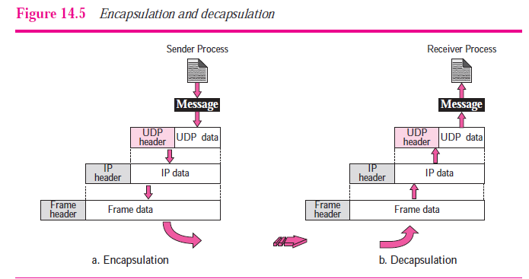
TCP/IP Protocol Suite
12

Slide 13
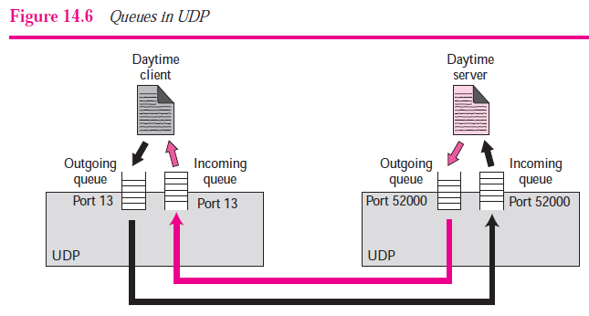
TCP/IP Protocol Suite
13

Slide 14
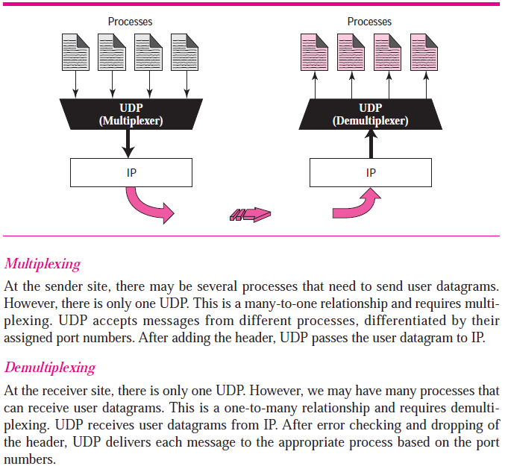
TCP/IP Protocol Suite
14

Slide 15
10-5 CHECKSUM
The error detection method we discuss here is called the checksum.
10.

Slide 16
Example 10.18
Suppose our data is a list of five 4-bit numbers that we want to send to a destination. In addition to sending these numbers, we send the sum of the numbers. For example, if the set of numbers is (7, 11, 12, 0, 6), we send (7, 11, 12, 0, 6, 36), where 36 is the sum of the original numbers. The receiver adds the five numbers and compares the result with the sum. If the two are the same, the receiver assumes no error, accepts the five numbers, and discards the sum. Otherwise, there is an error somewhere and the data are not accepted.
10.

Slide 17
Example 10.19
We can make the job of the receiver easier if we send the negative (complement) of the sum, called the checksum. In this case, we send (7, 11, 12, 0, 6, −36). The receiver can add all the numbers received (including the checksum). If the result is 0, it assumes no error; otherwise, there is an error.
10.

Slide 18
Example 10.20
How can we represent the number 21 in one’s complement arithmetic using only four bits?
Solution
The number 21 in binary is 10101 (it needs five bits). We can wrap the leftmost bit and add it to the four rightmost bits. We have (0101 + 1) = 0110 or 6.
10.

Slide 19
Example 10.21
How can we represent the number −6 in one’s complement arithmetic using only four bits?
Solution
In one’s complement arithmetic, the negative or complement of a number is found by inverting all bits. Positive 6 is 0110; negative 6 is 1001. If we consider only unsigned numbers, this is 9.
10.

Slide 20
Example 10.22
using one’s complement arithmetic. Figure 10.24 shows the process at the sender and at the receiver. The sender initializes the checksum to 0 and adds all data items and the checksum (the checksum is considered as one data item and is shown in color). The result is 36. However, 36 cannot be expressed in 4 bits. The extra two bits are wrapped and added with the sum to create the wrapped sum value 6. In the figure, we have shown the details in binary. The sum is then complemented, resulting in the checksum value 9 (15 − 6 = 9). The sender now sends six data items to the receiver including the checksum 9.
10.

Slide 21
Example 10.22 (continued)
The receiver follows the same procedure as the sender. It adds all data items (including the checksum); the result is 45. The sum is wrapped and becomes 15. The wrapped sum is complemented and becomes 0. Since the value of the checksum is 0, this means that the data is not corrupted. The receiver drops the checksum and keeps the other data items. If the checksum is not zero, the entire packet is dropped.
10.

Slide 22
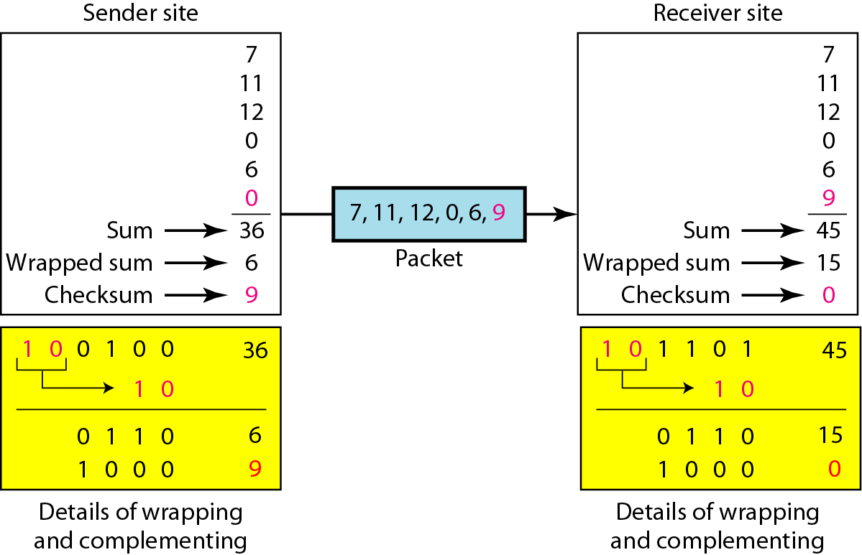
Figure 10.24 Example 10.22
1111
0000
1
10.

Slide 23
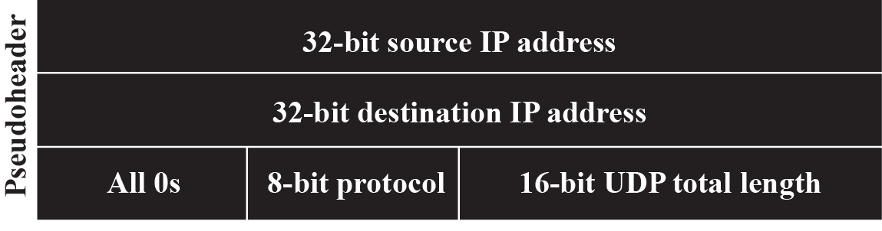
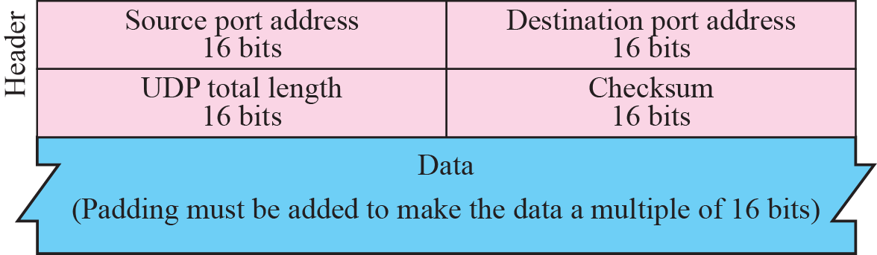
Figure 14.3 Pseudoheader for checksum calculation
TCP/IP Protocol Suite
23
Notes:
23

Slide 24
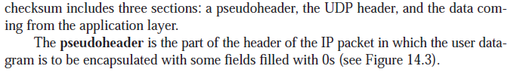
TCP/IP Protocol Suite
24

Slide 25
Example 14.2
Figure 14.4 shows the checksum calculation for a very small user datagram with only 7 bytes of data. Because the number of bytes of data is odd, padding is added for checksum calculation. The pseudoheader as well as the padding will be dropped when the user datagram is delivered to IP.
TCP/IP Protocol Suite
25
Notes:
25

Slide 26
Figure 14.3 Pseudoheader for checksum calculation
TCP/IP Protocol Suite
26
Notes:
26

Slide 27
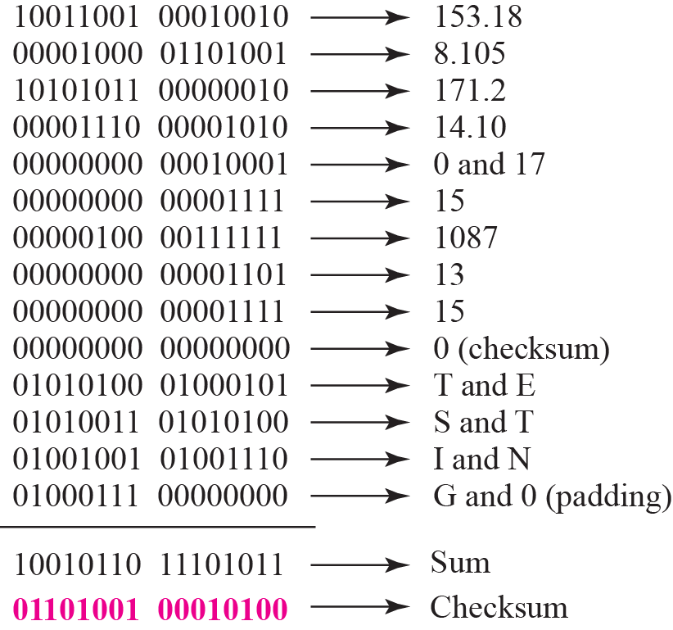
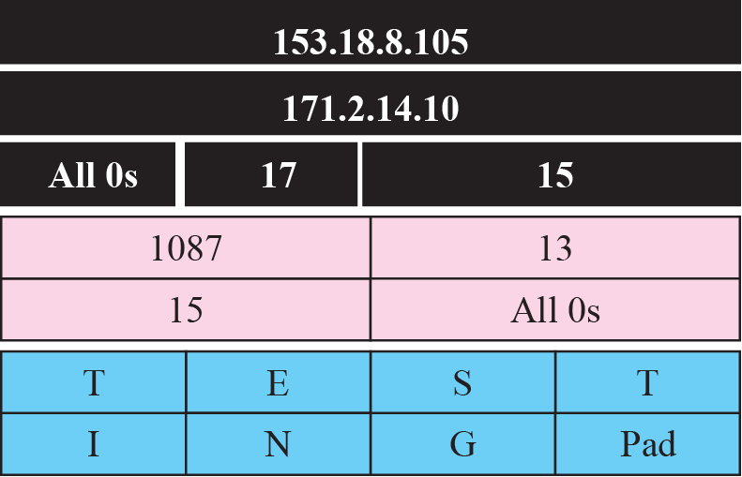
Figure 14.4 Checksum calculation for a simple UDP user datagram
TCP/IP Protocol Suite
27
Notes:
27

Slide 28

Note
UDP is an example of the connectionless simple protocol with the exception of an optional checksum added to packets for error detection.
TCP/IP Protocol Suite
28
Notes:
28

Slide 29
UDP APPLICATION
TCP/IP Protocol Suite
29
Notes:
29

Slide 30
Example 14.4
A client-server application such as DNS uses the services of UDP because a client needs to send a short request to a server and to receive a quick response from it. The request and response can each fit in one user datagram. Since only one message is exchanged in each direction, the connectionless feature is not an issue; the client or server does not worry that messages are delivered out of order.
TCP/IP Protocol Suite
30
Notes:
30

Slide 31
Example 14.5
A client-server application such as SMTP ,which is used in electronic mail, cannot use the services of UDP because a user can send a long e-mail message, which may include multimedia (images, audio, or video). If the application uses UDP and the message does not fit in one single user datagram, the message must be split by the application into different user datagrams. Here the connectionless service may create problems. The user datagrams may arrive and be delivered to the receiver application out of order. The receiver application may not be able to reorder the pieces. This means the connectionless service has a disadvantage for an application program that sends long messages.
TCP/IP Protocol Suite
31
Notes:
31

Slide 32
Example 14.6
Assume we are downloading a very large text file from the Internet. We definitely need to use a transport layer that provides reliable service. We don’t want part of the file to be missing or corrupted when we open the file. The delay created between the delivery of the parts are not an overriding concern for us; we wait until the whole file is composed before looking at it. In this case, UDP is not a suitable transport layer protocol.
TCP/IP Protocol Suite
32
Notes:
32

Slide 33
Example 14.7
Assume we are watching a real-time stream video on our computer. Such a program is considered a long file; it is divided into many small parts and broadcast in real time. The parts of the message are sent one after another. If the transport layer is supposed to resend a corrupted or lost frame, the synchronizing of the whole transmission may be lost. The viewer suddenly sees a blank screen and needs to wait until the second transmission arrives. This is not tolerable. However, if each small part of the screen is sent using one single user datagram, the receiving UDP can easily ignore the corrupted or lost packet and deliver the rest to the application program. That part of the screen is blank for a very short period of the time, which most viewers do not even notice. However, video cannot be viewed out of order, so streaming audio, video, and voice applications that run over UDP must reorder or drop frames that are out of sequence.
TCP/IP Protocol Suite
33
Notes:
33

Slide 34
14-5 UDP PACKAGE
To show how UDP handles the sending and receiving of packets, we present a simple version of the UDP package.
We can say that the UDP package involves five components: a control-block table, input queues, a control-block module, an input module, and an output module.
TCP/IP Protocol Suite
34
Notes:
34

Slide 35
Control-Block Table
Input Queues
Control-Block Module
Input Module
Output Module
TCP/IP Protocol Suite
35
Notes:
35

Slide 36
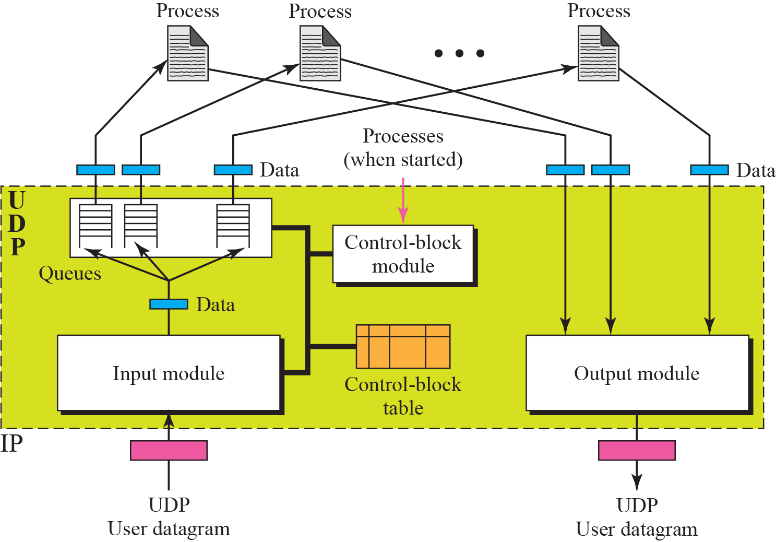
Figure 14.8 UDP design
TCP/IP Protocol Suite
36
Notes:
36

Slide 37
Control-Block Table
In our package, UDP has a control-block table to keep track of the open ports.
Each entry in this table has a minimum of four fields: the state, which can be FREE or IN-USE, the process ID, the port number, and the corresponding queue number.
TCP/IP Protocol Suite
37

Slide 38
Input Queues
Our UDP package uses a set of input queues, one for each process.
TCP/IP Protocol Suite
38

Slide 39
Control-Block Module
The control-block module is responsible for the management of the control-block table.
When a process starts, it asks for a port number from the operating system. The operating system assigns well-known port numbers to servers and ephemeral port numbers to clients.
The process passes the process ID and the port number to the control-block module to create an entry in the table for the process.
TCP/IP Protocol Suite
39

Slide 40
Figure 14.8 UDP design
TCP/IP Protocol Suite
40
Notes:
40

Slide 41
Input module
The input module receives a user datagram from the IP. It searches the control-block table to find an entry having the same port number as this user datagram.
If the entry is found, the module uses the information given to enqueue the data.
If the entry is not found, it generates an ICMP message.

Slide 42
Output module
The output module is responsible for creating and sending user datagrams.
TCP/IP Protocol Suite
42

